Slide 1

Vocabulary in Reading Study
(VIRS)

Slide 2
Our Team
Capstone 2
Regine Donatien
Diego Chacin
Javier Duenas
Jason Naya
Capstone 1
Michelle Cruz
Mentor: Seyedjafar Ehsanzadehsorati
Instructor: Dr. Masoud Sadjadi, Florida International University

Slide 3
The Problem
English Language Learners (ELL) constantly face a challenge:
Not having an all-encompassing practical solution to learning vocabulary.
It is difficult to find options for ELL and their educators that allows them to:
Measure the difficulty level of text, which can either challenge or discourage the learner.
See definitions of words in a text that they are interested to learn.
Chose words they want to focus on based on categories such as frequently used words.

Slide 4
What is VIRS?

Slide 5
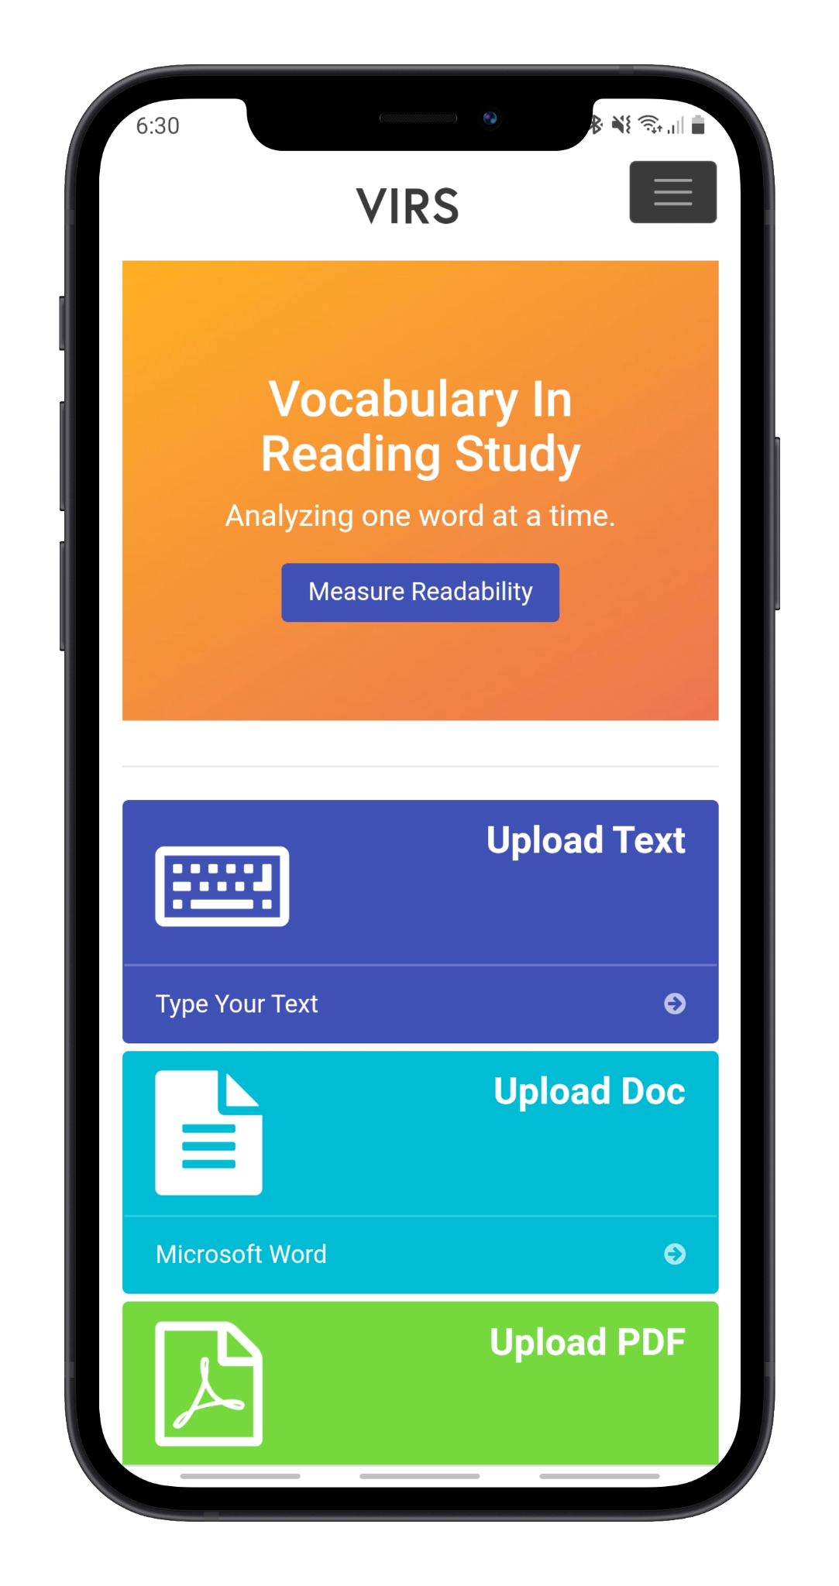
VIRS is a web application that...
Analyzes the user’s upload document can categorized the words by difficulty
Allows the user to easily view the definition of words
Pinpoint words that they would like to focus on based on their frequency and category
Assess their learning through vocabulary quizzes

Slide 6




Technologies
Angular Model View Controller is used for the front end.
Backend is written in Java.
MySQL is used as the database and the data queries are auto generated by Spring Data JPA.
The application is deployed on AWS elastic beanstalk.

Slide 7
Website Overview
Page | Functionality
Home page | Greets the user. Gives option to upload a file to be analyzed
Analyze Text: Enhanced Text | Color codes words based on difficulty.
Analyze Text: Statistics | Provides an in-depth analysis on the difficulty of the text and frequency of certain words.
Word List | Gives learners a list of words that they should learn and allows them to easily see the definition.
iTranslate | Translates a given text to a number of different languages
Register/User Recovery | Create an account and retrieve lost credentials.

Slide 8
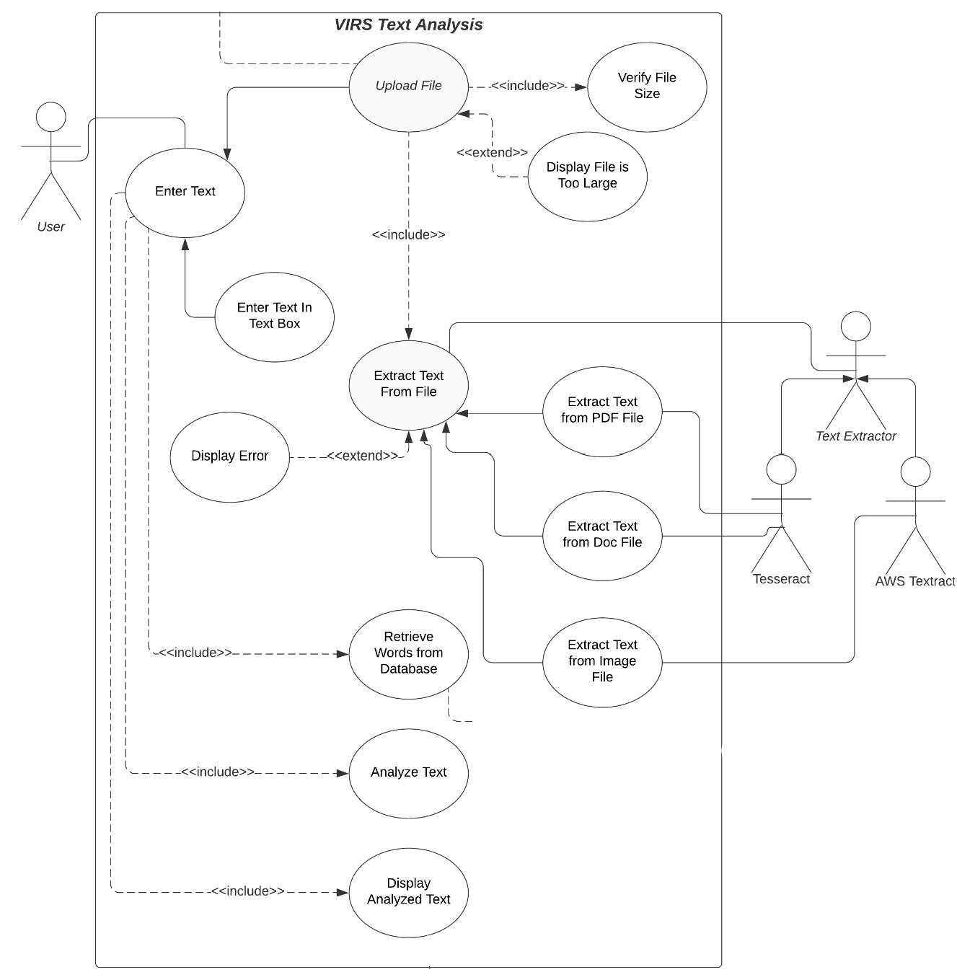
This is how the website functions for text analysis.

Slide 9
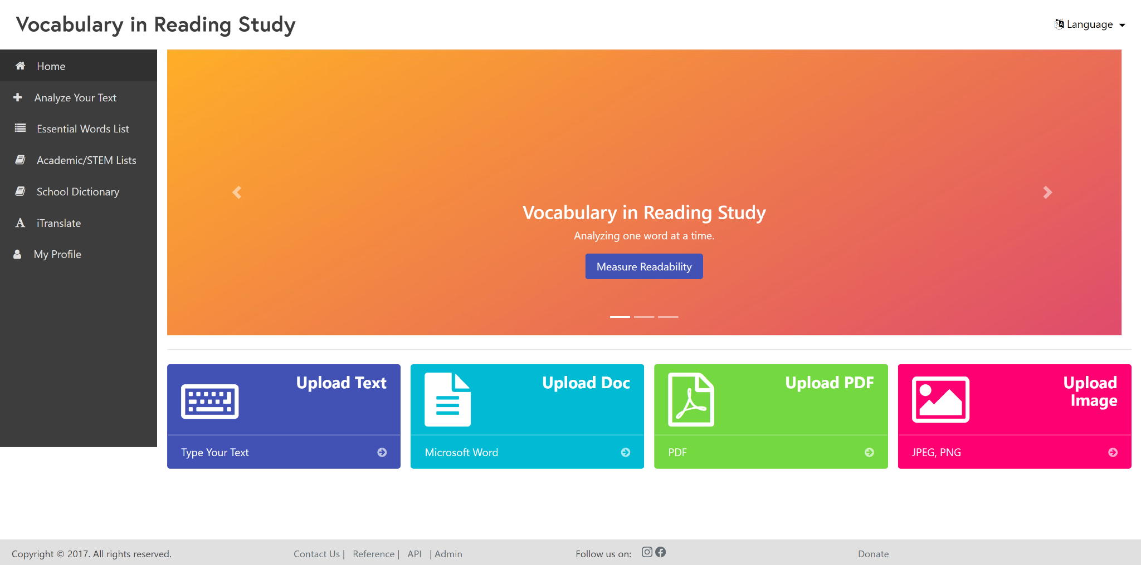
Home Page

Slide 10
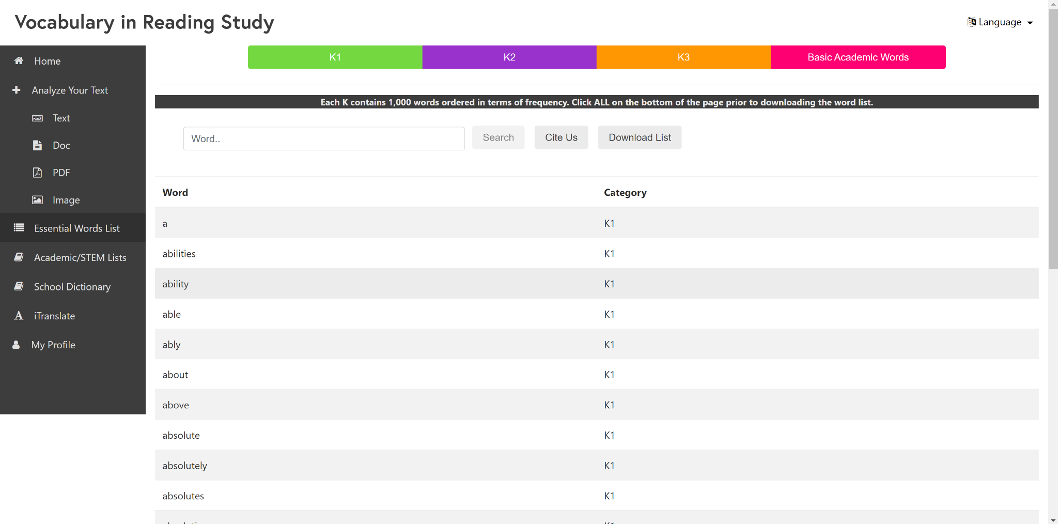
Word List

Slide 11
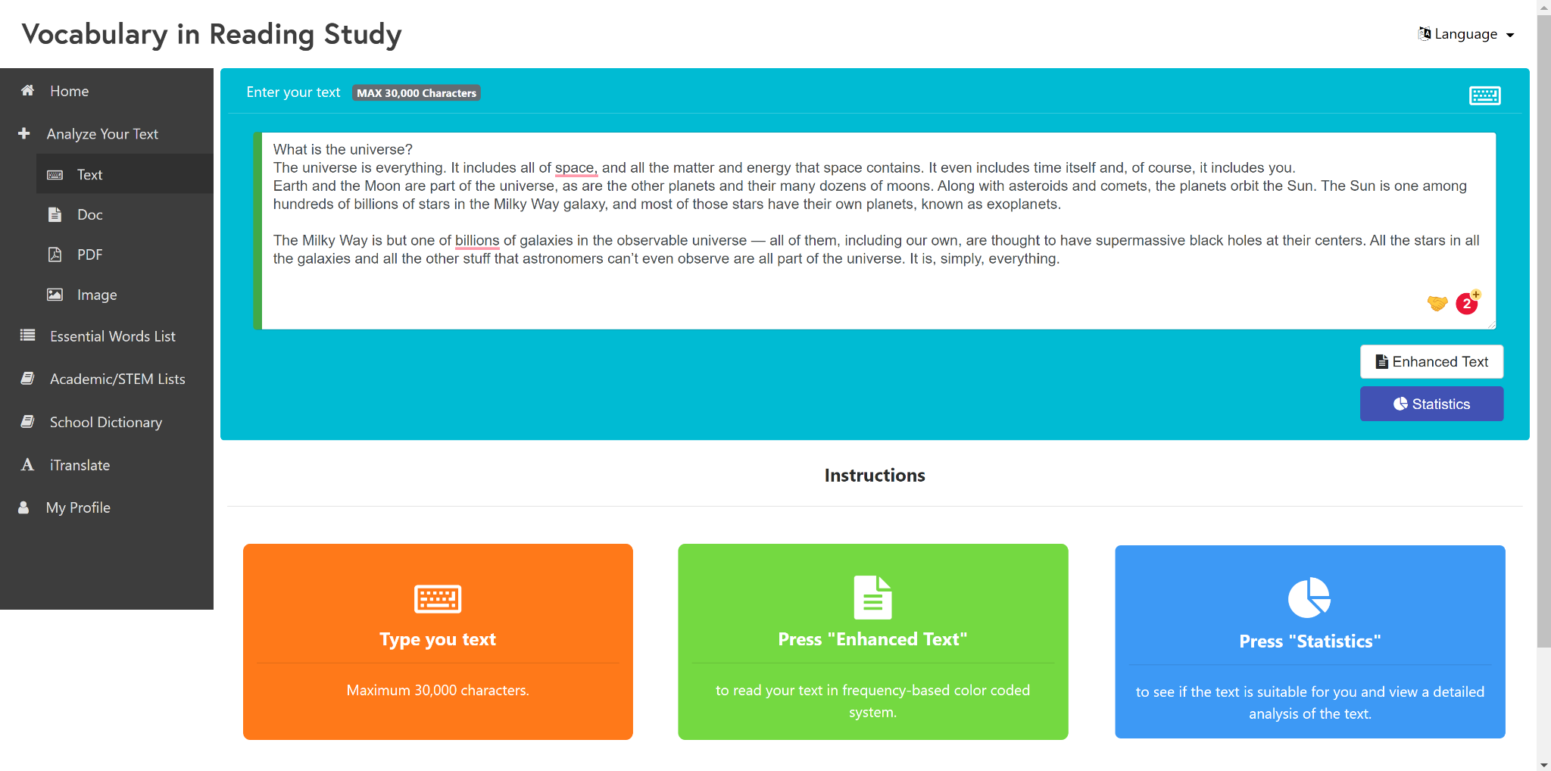
Analyze Text

Slide 12
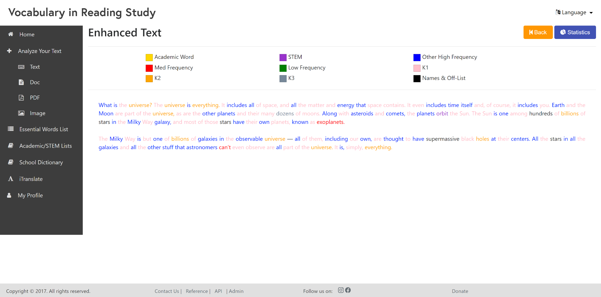
Enhanced Text

Slide 13
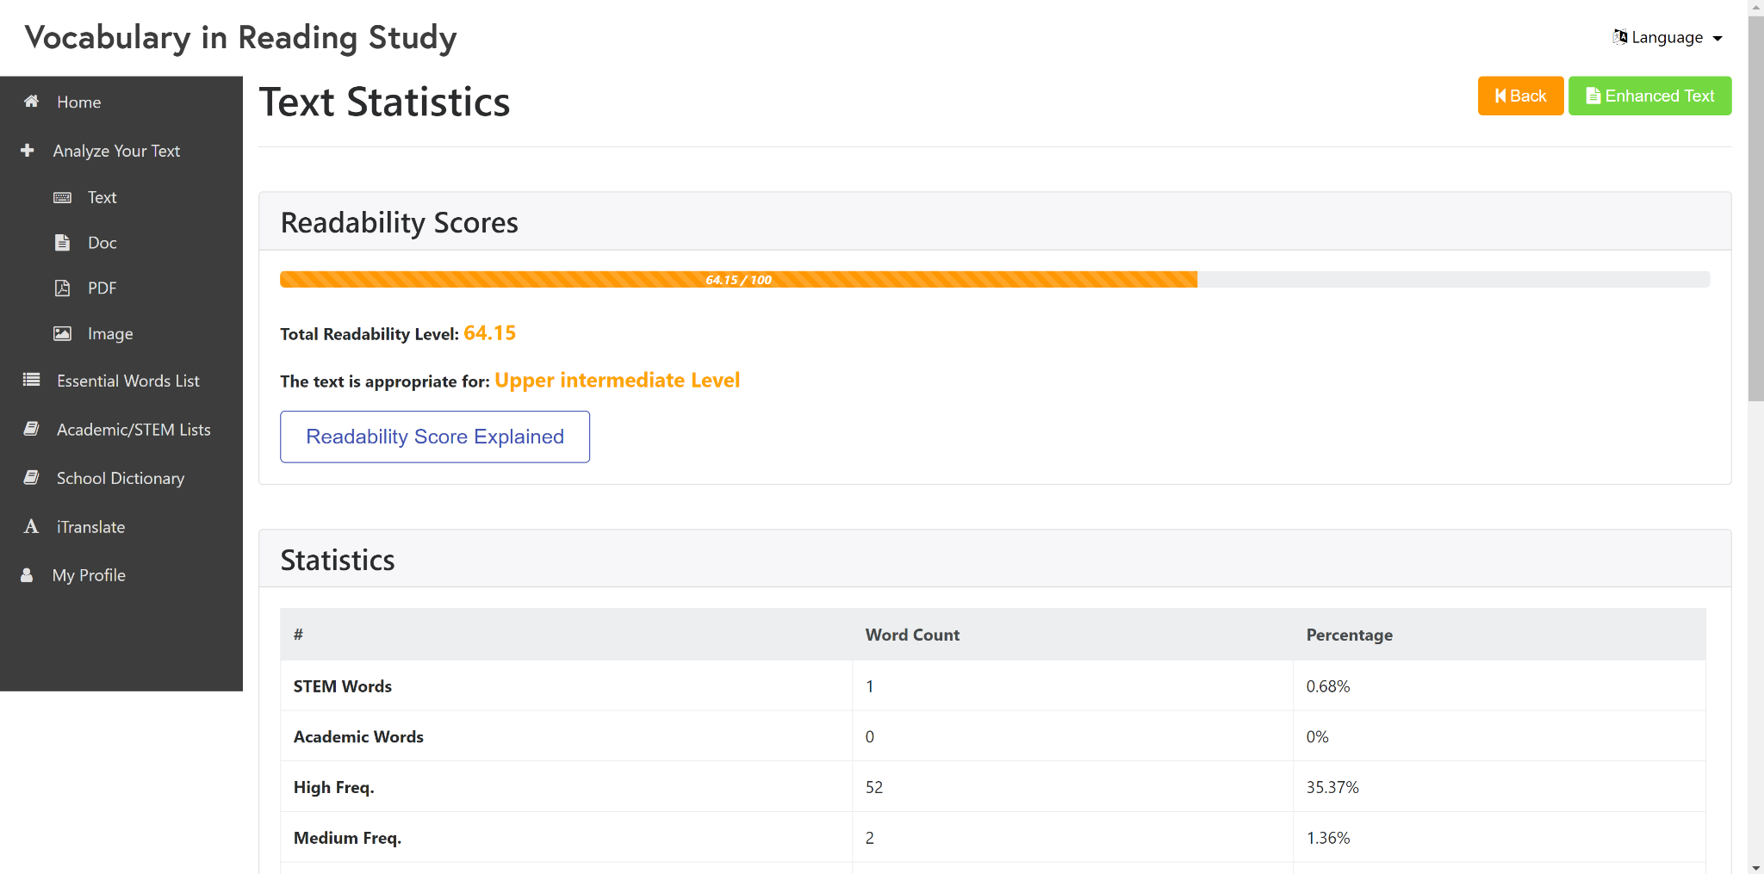
Text Statistics

Slide 14
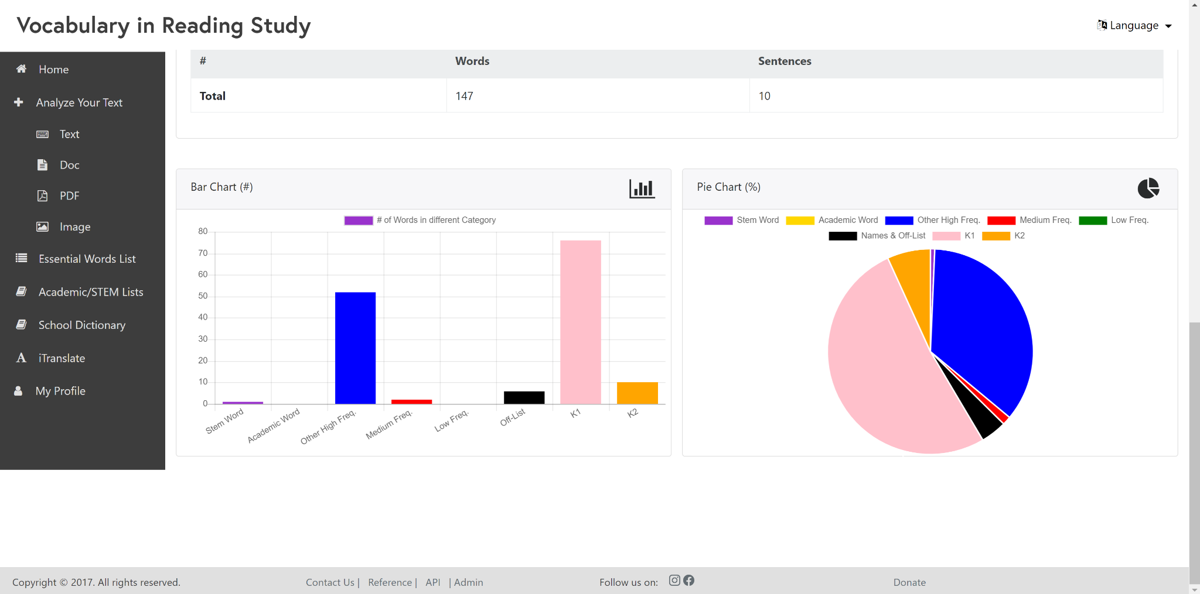
Text Statistics

Slide 15
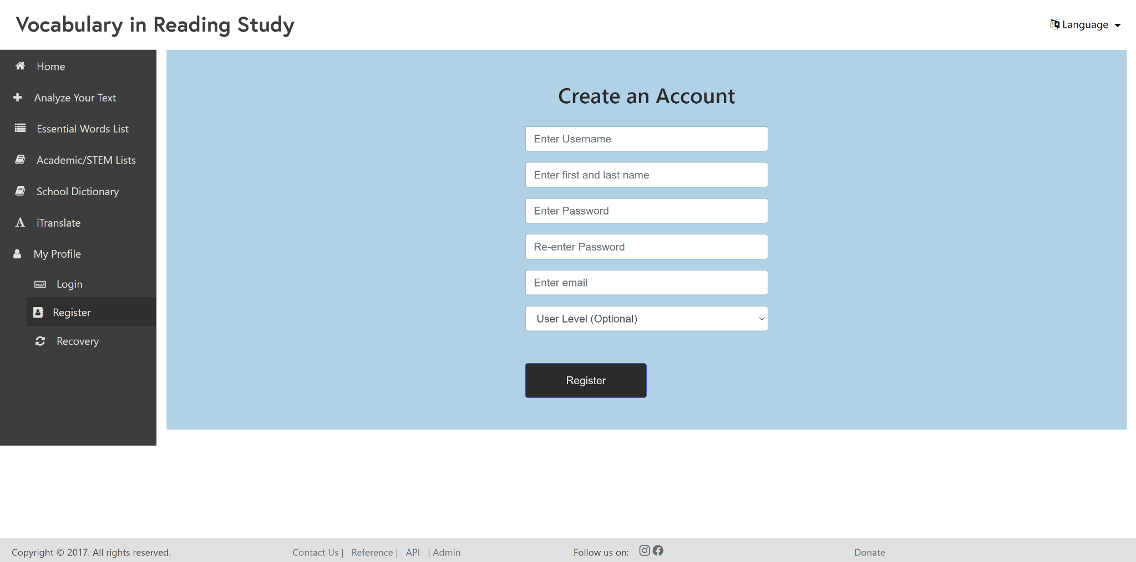
Register

Slide 16
Changes
User Interface

Slide 17
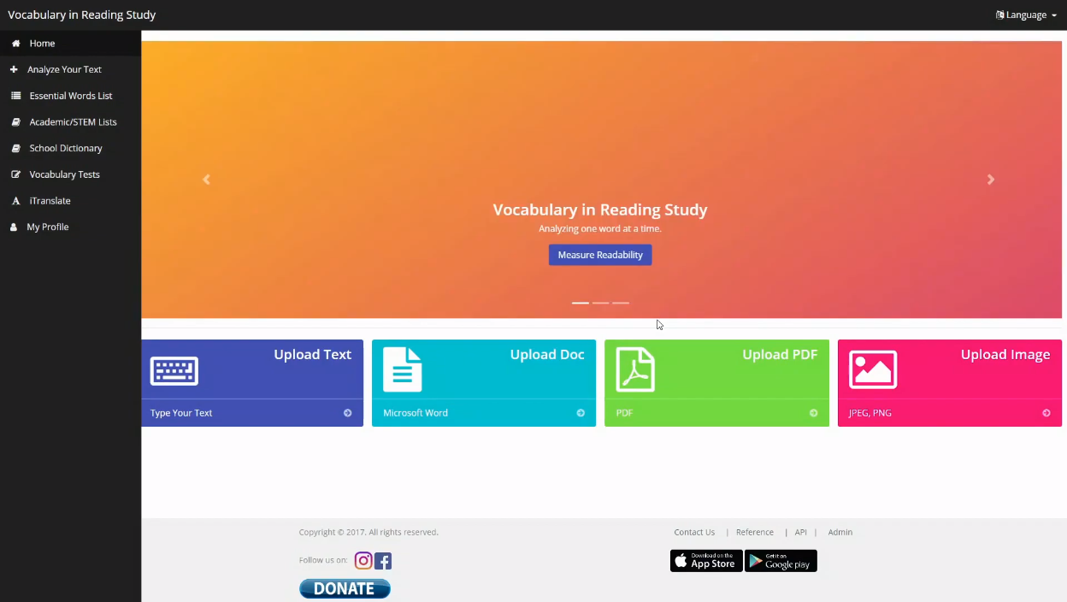
Old vs New

Slide 18
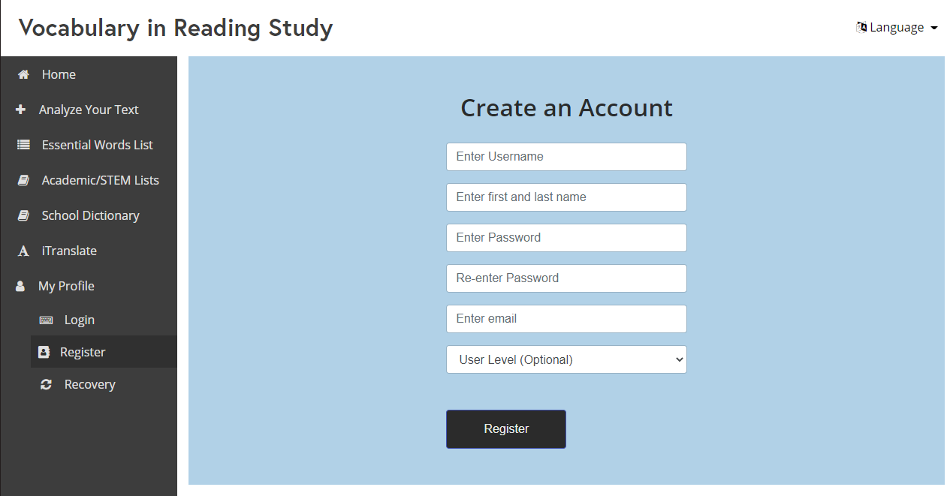
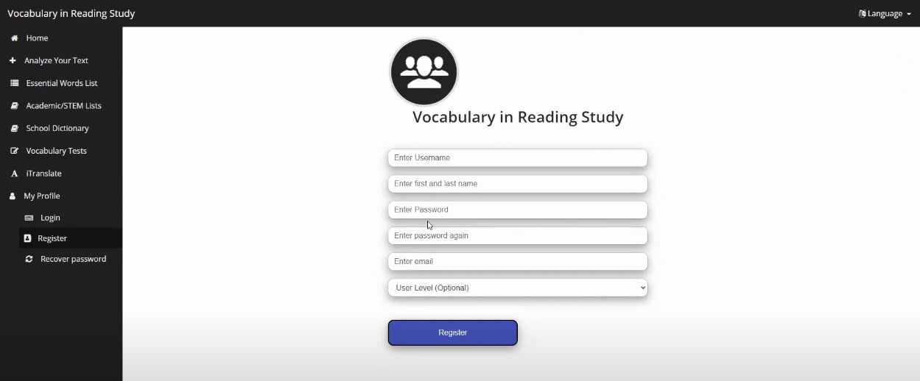
Old vs New

Slide 19
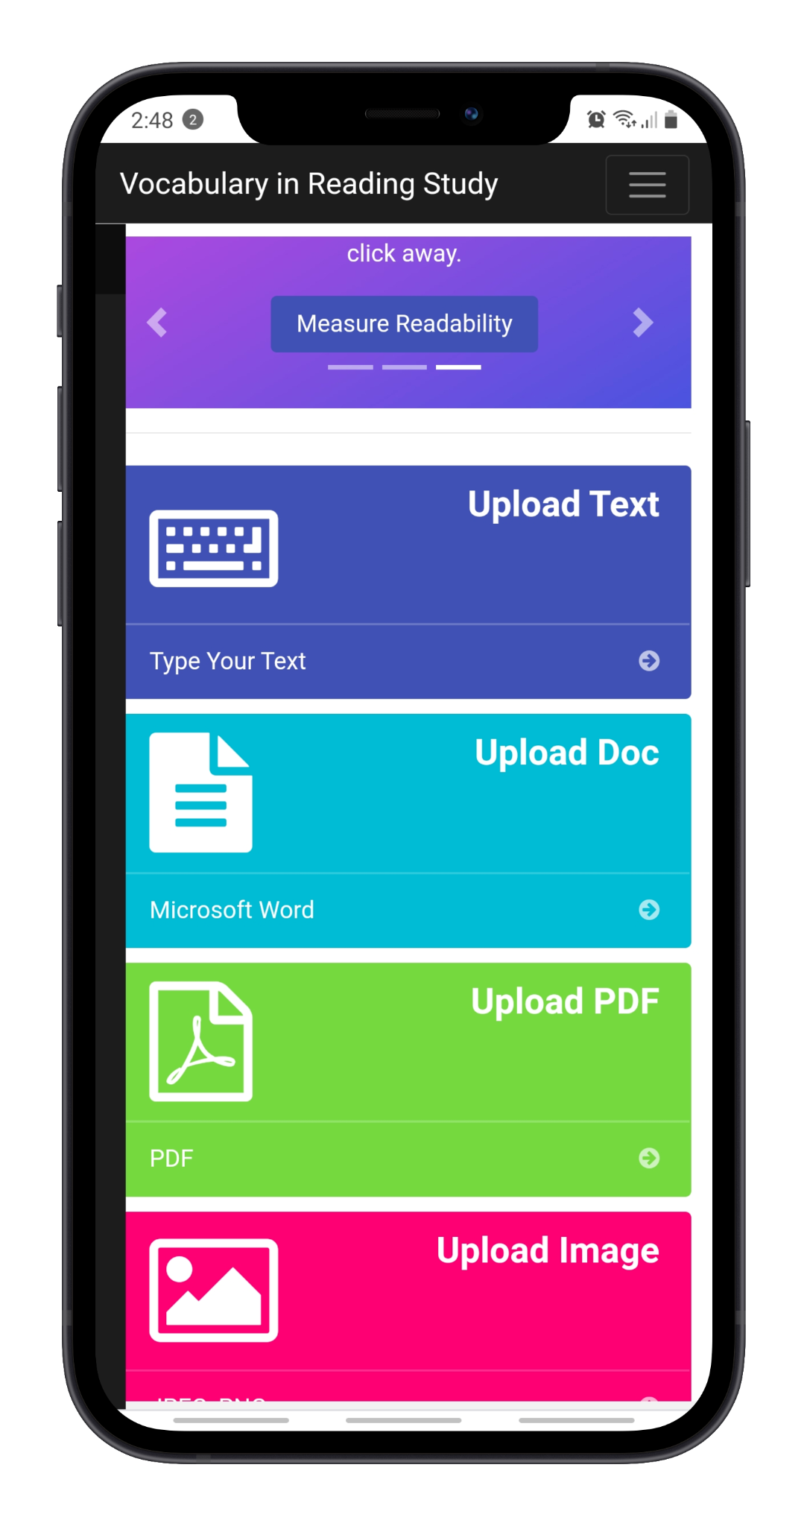
MOBILE:
Homepage

Slide 20
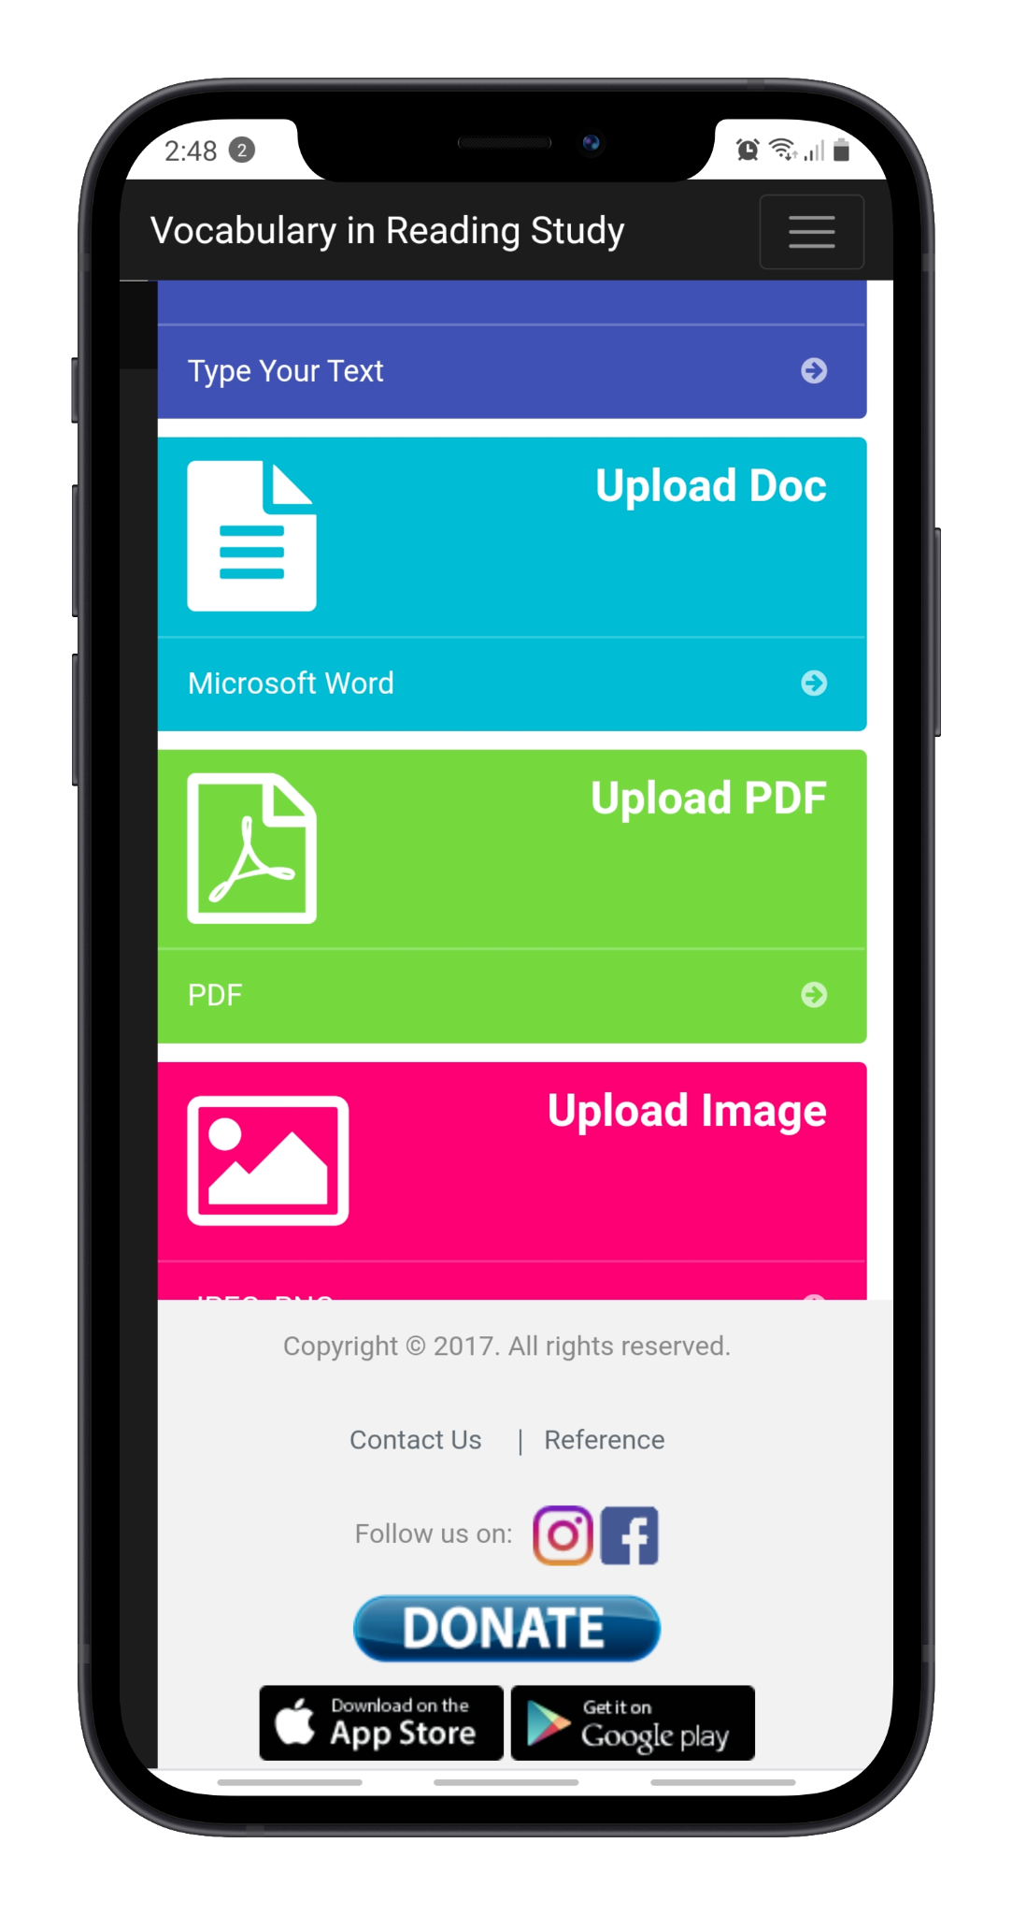
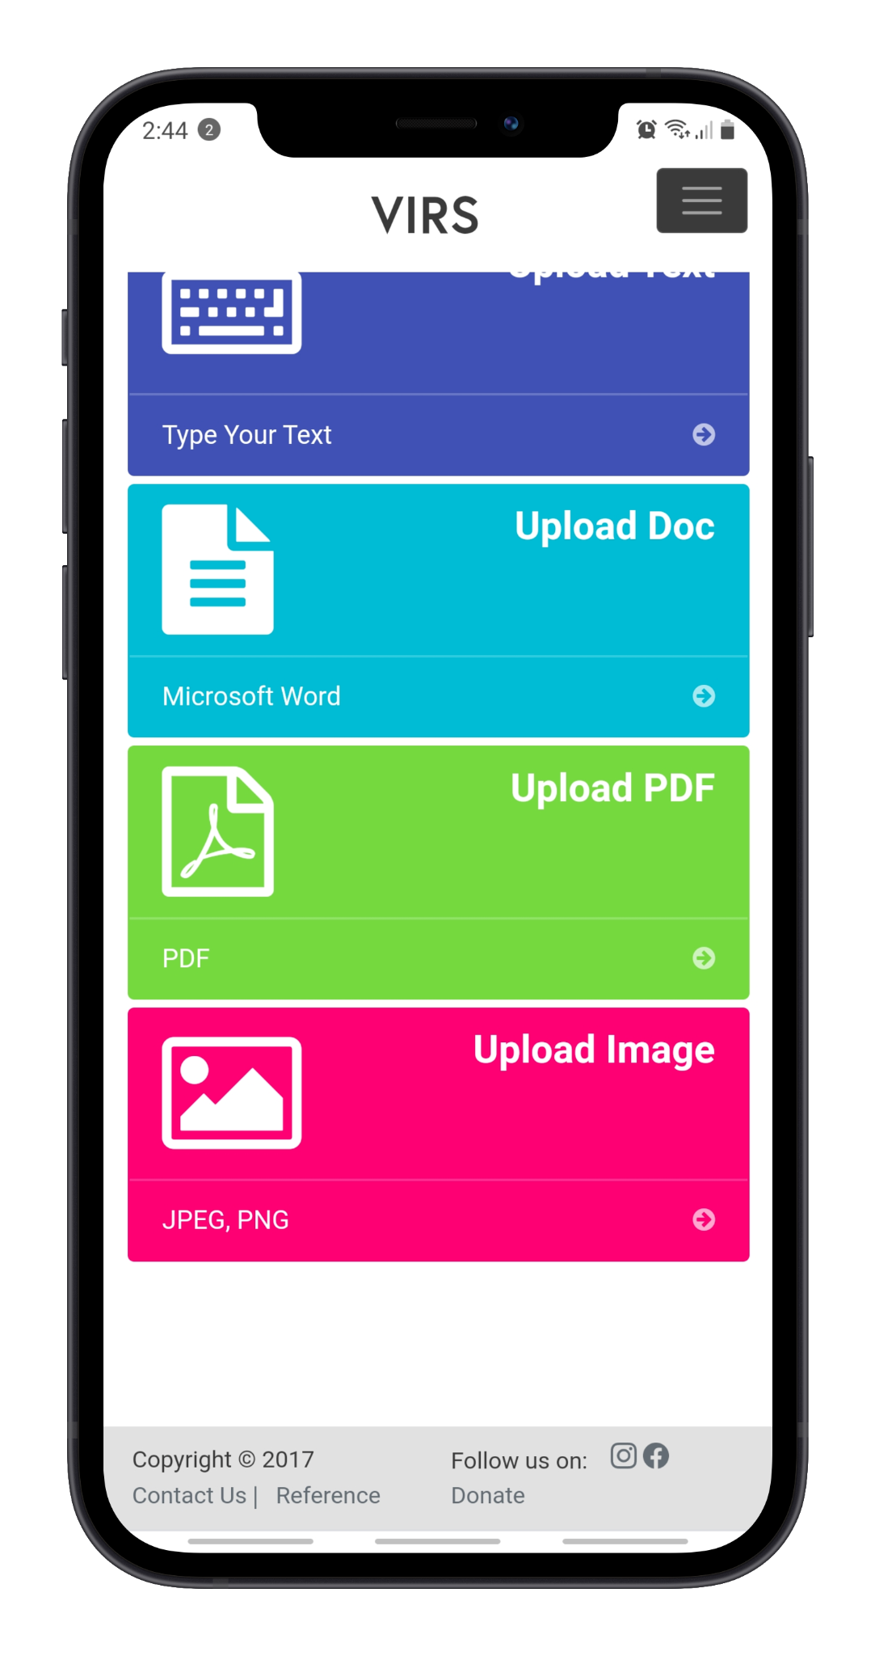
MOBILE:
Footer

Slide 21
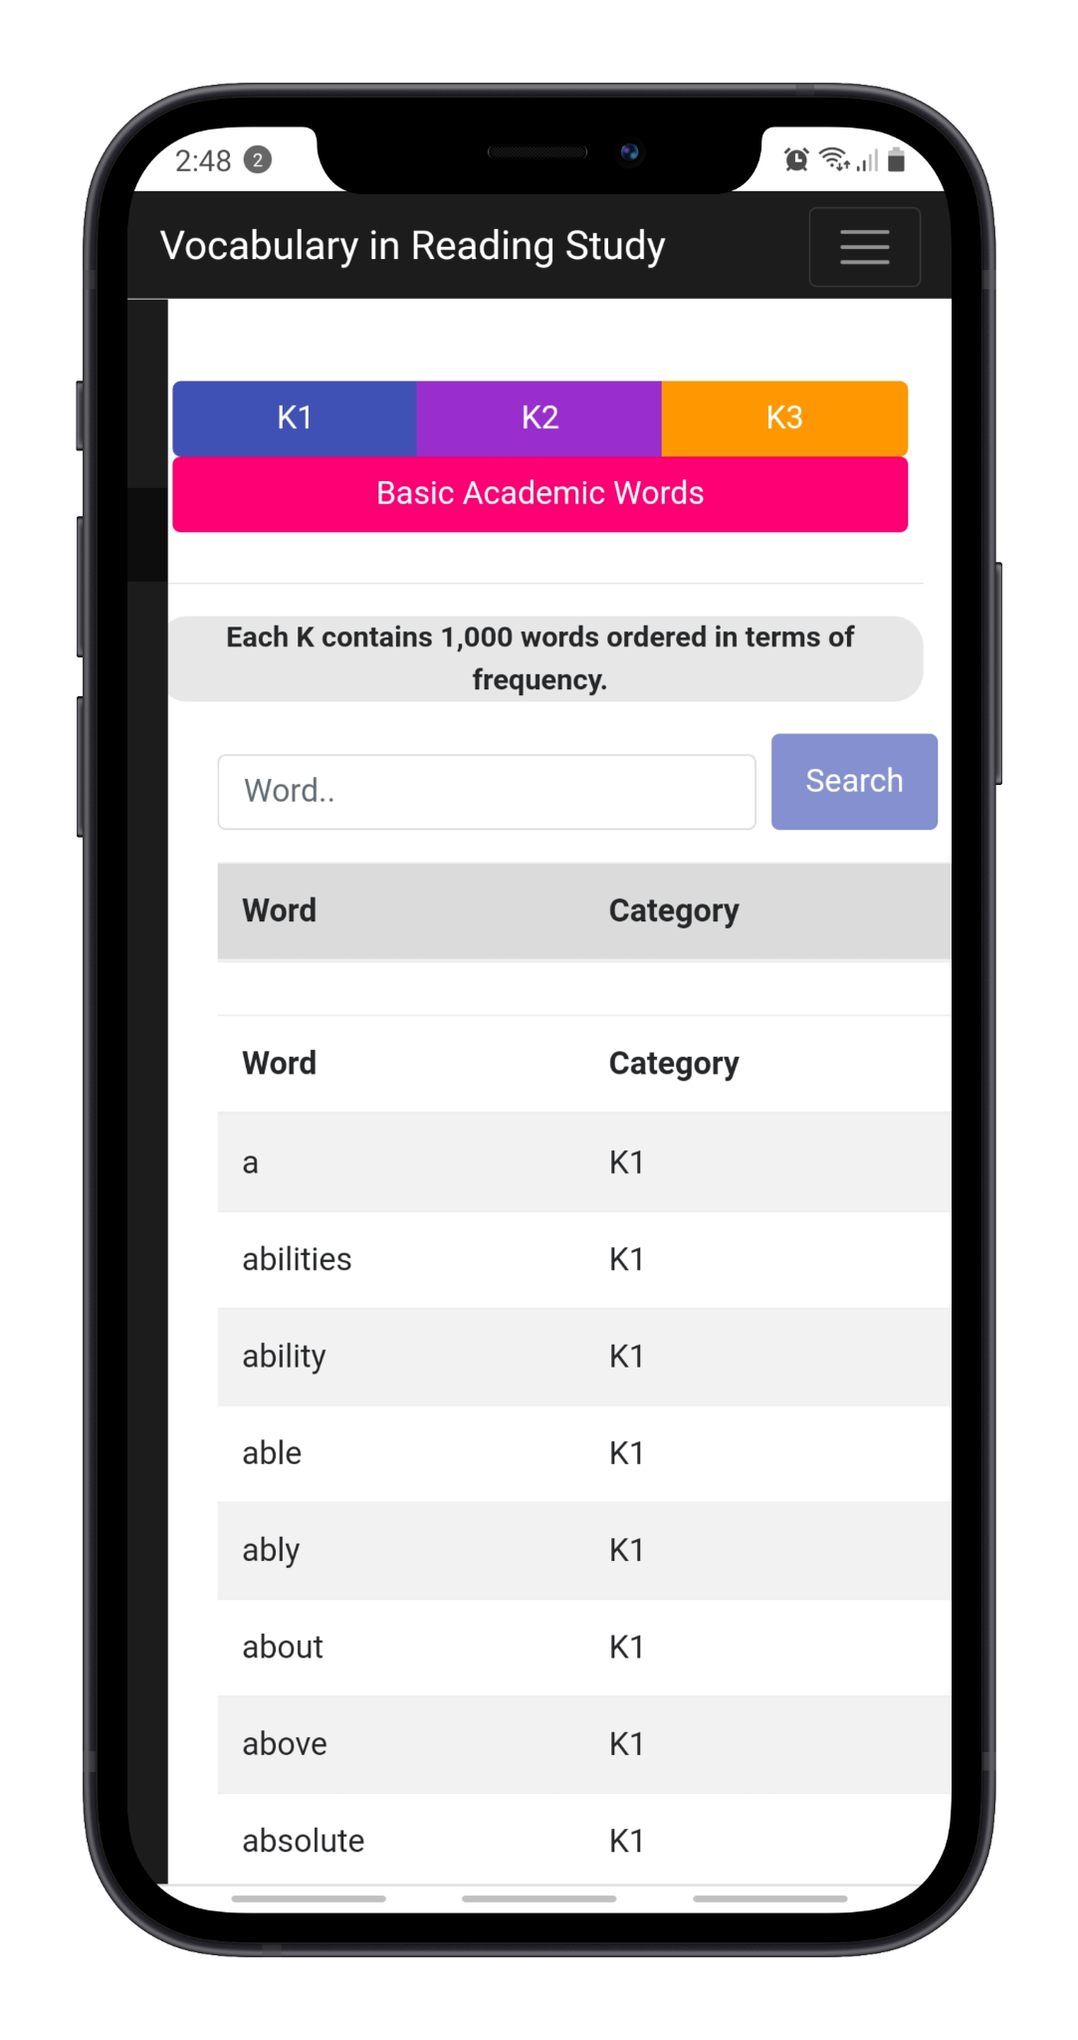
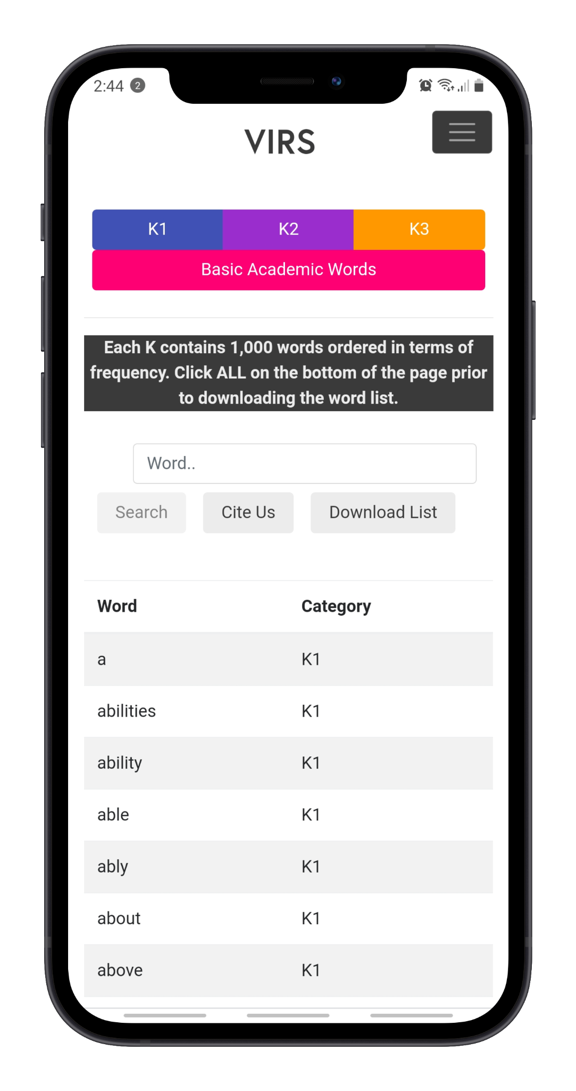
MOBILE:
Essential
Word List

Slide 22
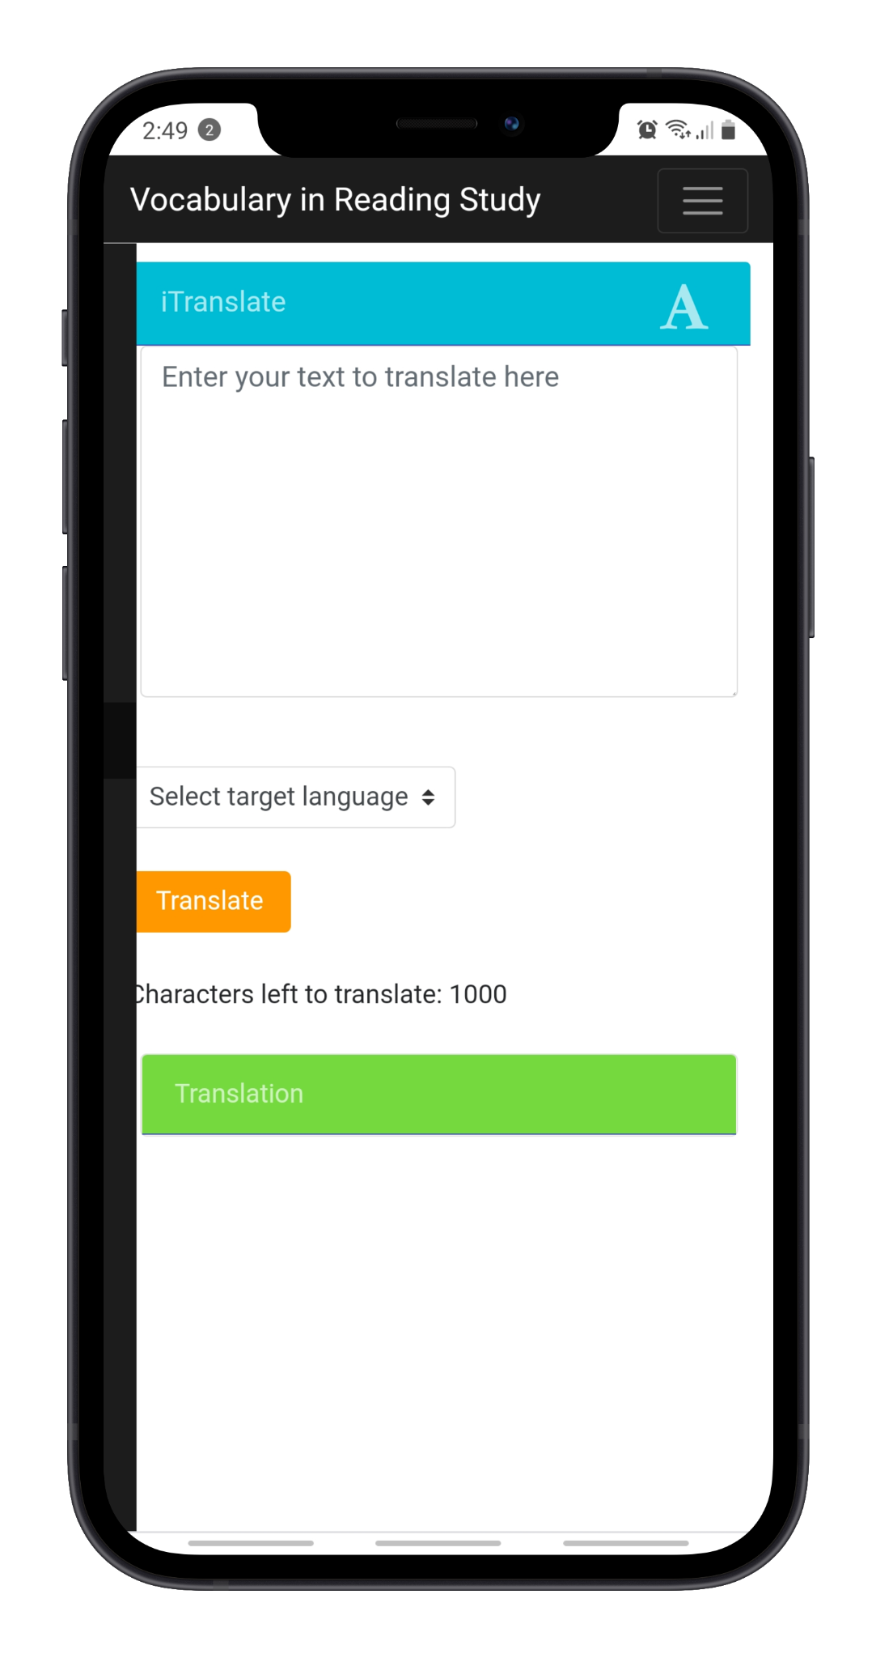
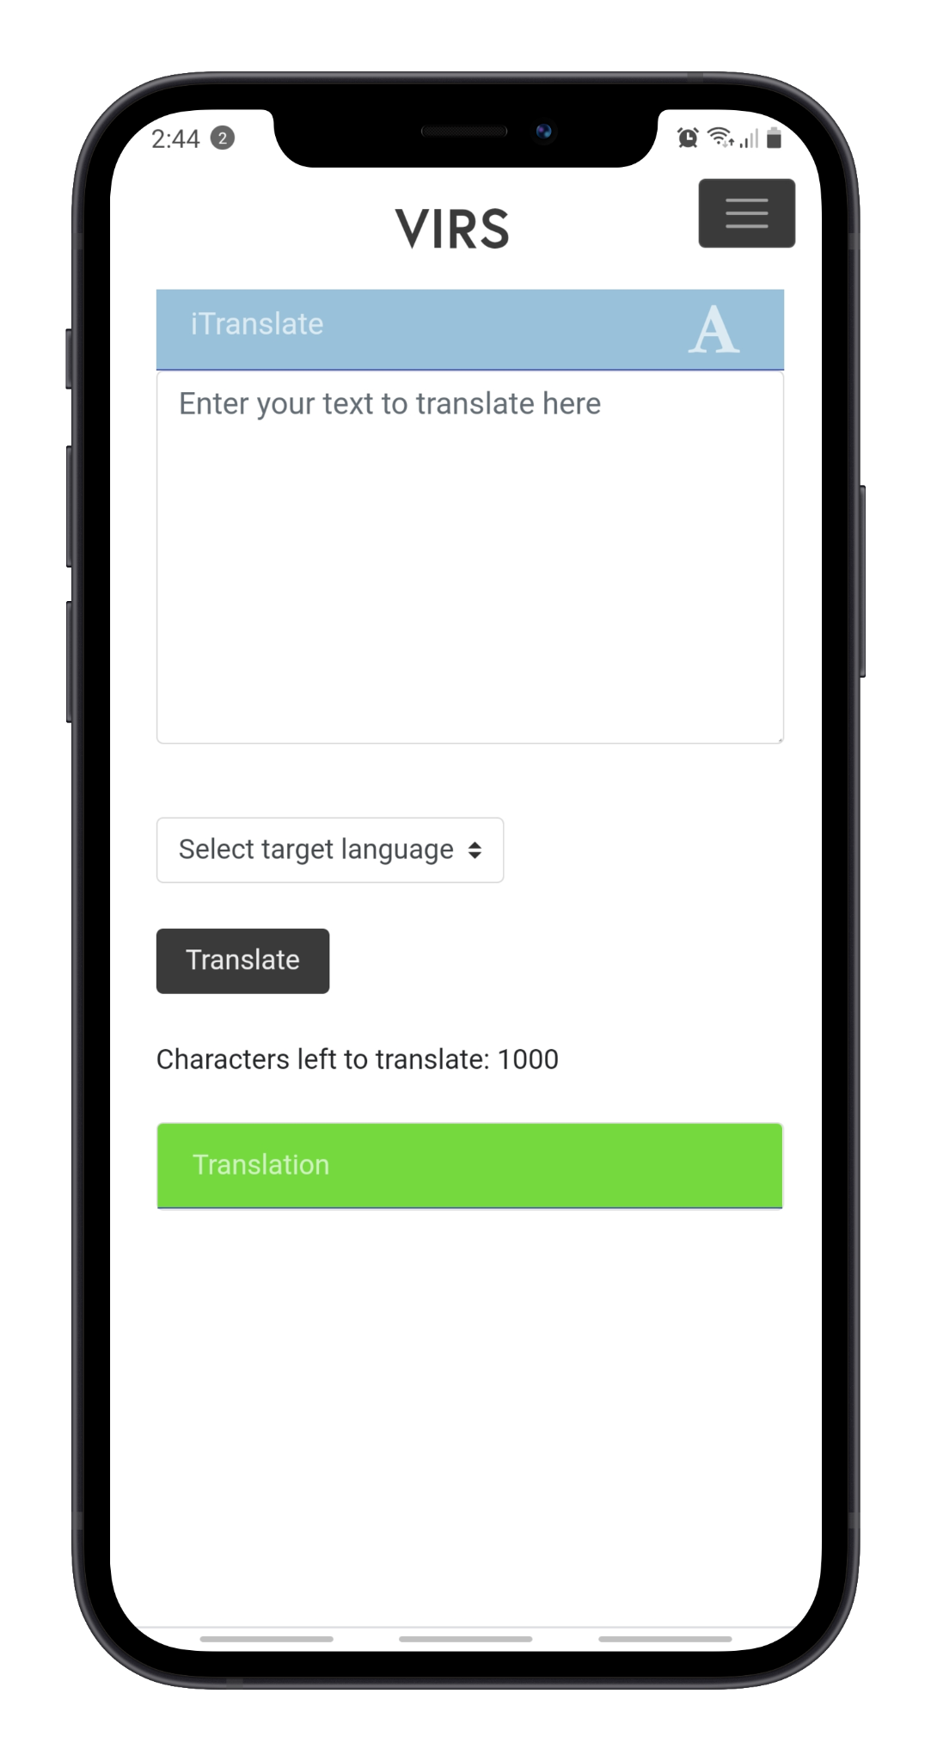
MOBILE:
iTranslate

Slide 23
Changes
Image Recognition

Slide 24
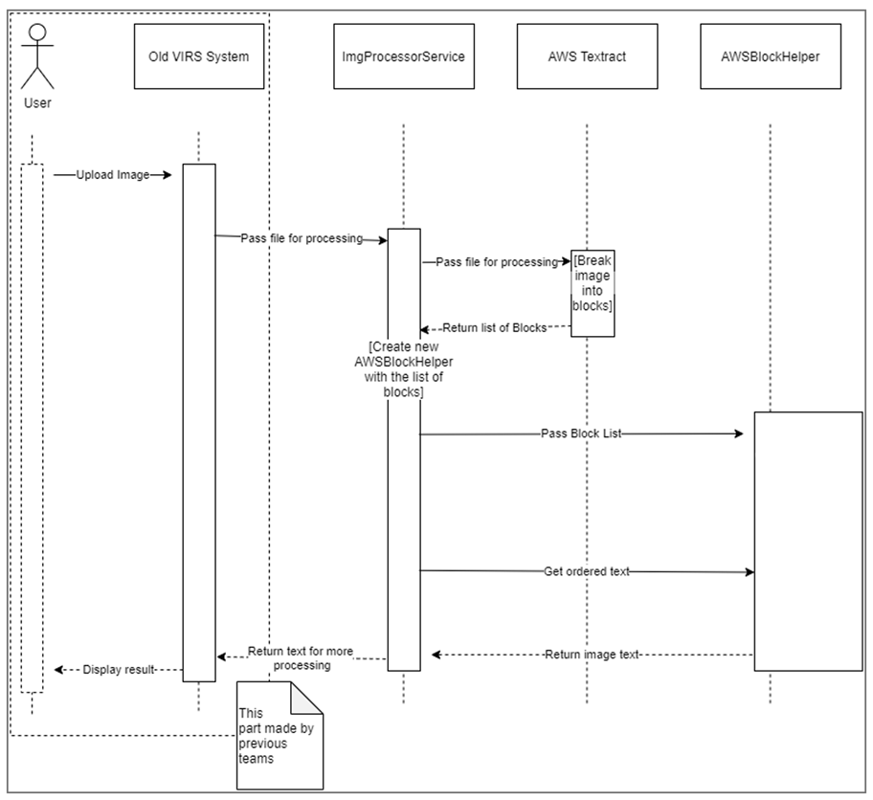
This is how the text gets processed.

Slide 25
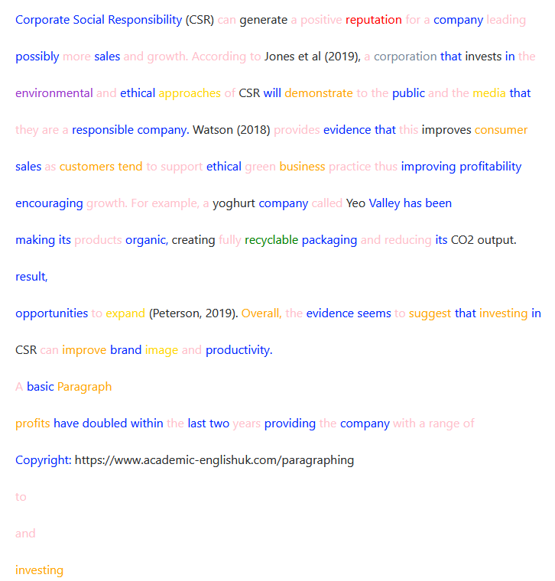
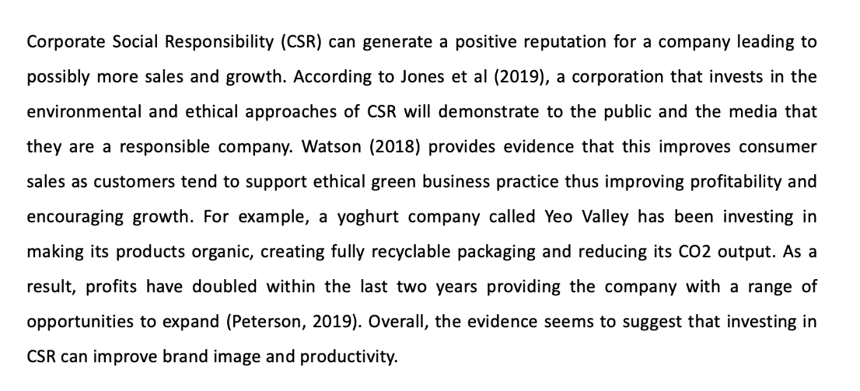
Fixing Image Recognition
Problems
Output is out of order, formatted improperly
Missing words
Causes
No image optimization implemented to image reader
Bugs in column recognition code
test paragraph - www.academic-englishuk.com/paragraphing
output from older version of website

Slide 26
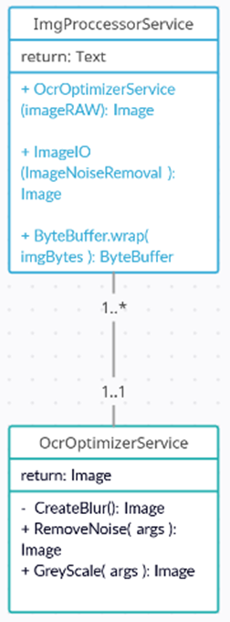
Fixing Image Recognition Cont.,
Solution
Implemented AWS OCR optimization
Reduces the amount of errors in recognition
Less missing words/mistakes
Ocr Optimization
Optical Character Recognition Optimization
Grey Scale
Blur
Noise Removal

Slide 27
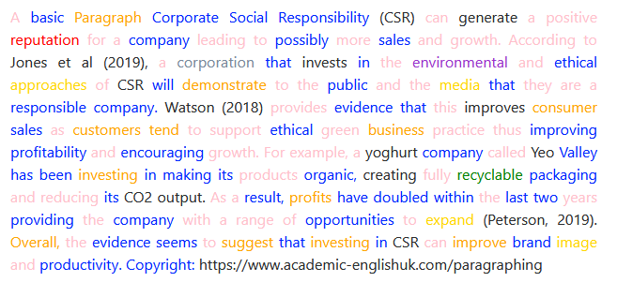
Fixing Image Recognition Cont.,
Problem
In the column recognition code, it would improperly chose blocks for random lines of text
Solution
Optimize the column recognition
Lower margin of error
After fixing column recognition error
Before fixing column recognition error

Slide 28


iOS app.
Program: Xcode 12
Language: Swift 5 using storyboard

Slide 29
LIVE DEMO!

